Slide 1
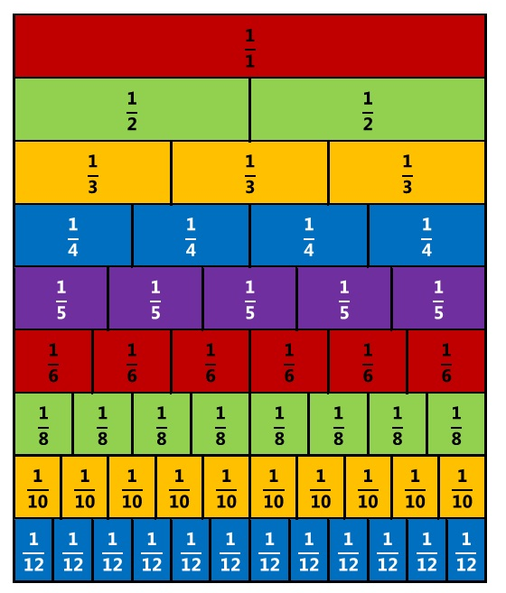
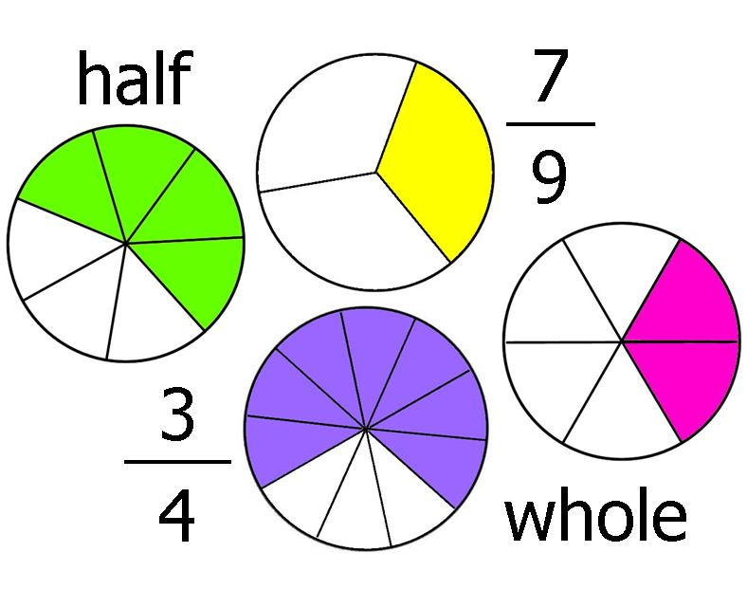
Fractions Challenges

Slide 2
Challenge 1
What fraction is shaded?
1
4
2
5
3
6

Slide 3
Challenge 2
Shade in each rectangle

Slide 4
Challenge 3
Put the fractions in order of size?
1
4
2
5
3
6

Slide 5
Challenge 4
Match up fractions which are equal and explain why

Slide 6
Challenge 5
Write down 5 fractions the same as:

Slide 7
Challenge 6
Write down 5 fractions the same as:
Work out the answer to:

Slide 8
Challenge 7
Write these fractions in their simplest form:

Slide 9
Challenge 8
Work out the answer to:

Slide 10
Challenge 9
Put these fractions into order using a calculator – explain your method

Slide 11
Challenge 10
Put these fractions into order without a calculator – explain your method

Slide 12
Challenge 11
Without a calculator work out – show your method of working
Then check using a calculator

Slide 13
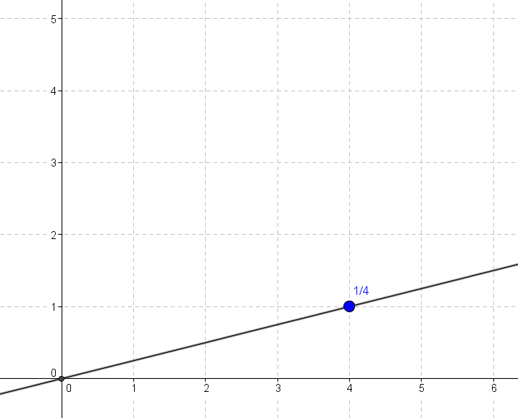
Challenge 12
Plot these fractions on a graph like the example shown – what do you notice?

Slide 14
Challenge 13
Without a calculator work out the answers to the following calculations

Slide 15
Challenge 14
Write down as many problems as you can with this answer

Slide 16
Challenge 15
Investigate the following
The sum of two fractions equals their product

